Slide 1
Optimizing Decision Trees and Random Forest Models
Laura Ye
March 15, 2018

Slide 2
Goals
The data is related to direct marketing campaigns (phone calls) of a Portuguese banking institution. The classification goal is to predict if the client will subscribe a term deposit.
Use decision trees and random forest models (with optimization)
Metrics used for comparison:
Accuracy
Area under the ROC curve (AUC)
ROC Plot

Slide 3
About the Data
Telemarketing data set obtained from UC Irvine’s Machine Learning Repository https://archive.ics.uci.edu/ml/datasets/bank+marketing
41188 rows, 21 columns (including response variable)
Explanatory variables include:
Age, job, marital status, education, default, housing, loan, contact, month, day of week, duration, campaign...

Slide 4
Data Preparation
Removed column with missing data: nr.employed
33425 rows of NAs
Only one value for the non-missing rows
Factorized Categorical Variables
Columns containing categorical variables like job, marital status, education… were factorized.
Removed columns with near-zero variance and zero variance
Column pdays was removed since there was only one value in the entire column
Split data into training set (70%), validation set (15%), test set (15%)

Slide 5
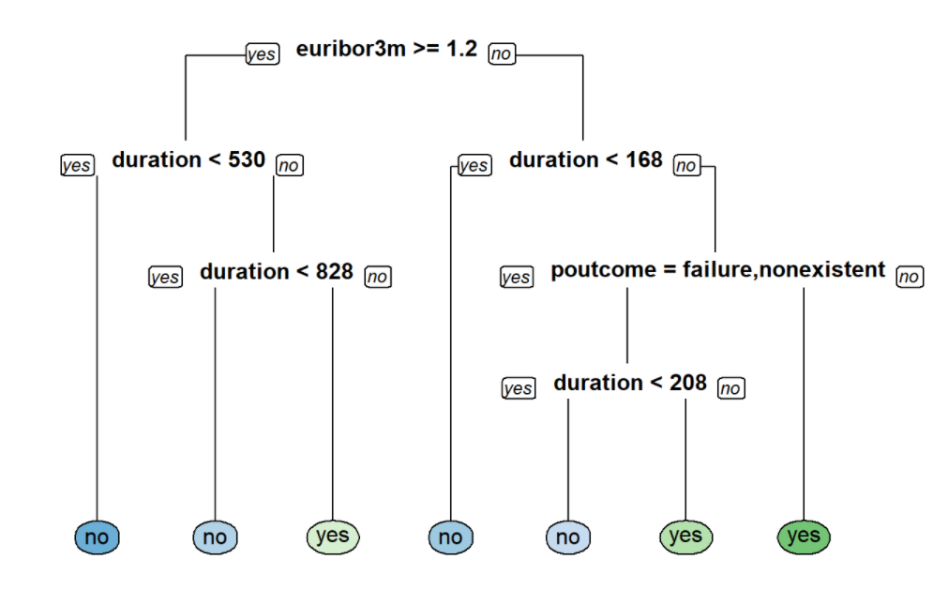
Decision Tree Model
Trained an initial decision tree that will be optimized using hyperparameters
Pros: Easy to visually interpret
Cons: Prone to overfitting, high variance

Slide 6
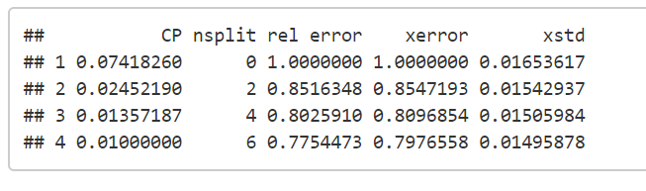
Tuning the Decision Tree Model
Hyperparameters to be tuned
cp (complexity parameter, default=0.1)
Minsplit (minimum number of data points required to attempt a split, default=20)
maxdepth (depth of a decision tree, default=30)
Cp was tuned by visually inspecting cp table

Slide 7
Tuning the Decision Tree Model
minsplit and maxdepth were tuned using a grid search.
minsplit range: 1-20, increments of 1
maxdepth range: 1-30, increments of 1
600 possibilities in total
Compared AUC for each model
Summary of results
Ideal Parameters
Minsplit: 20 (default)
Maxdepth: 3
AUC | 0.5 | 0.676 | 0.7495 | 0.7576
Total | 20 | 20 | 540 | 20

Slide 8
Random Forest Model
Trained an initial random forest model that will be optimized using hyperparameters
Pros: Reduces variance without increasing error and decorrelates trees
Cons: Loses visual interpretability
Hyperparameters:
mtry (number of variables to sample at each split, default=4 for this data set)
nodesize (controls complexity, default=1)
sampsize (controls variability and randomness, 63.2% of observations)

Slide 9
Tuning the Random Forest Model
mtry, nodesize, sampsize were tuned using a grid search against the validation set
mtry range: 2-8, increments of 2
nodesize range: 2-8, increments of 2
sampsize range: 70 or 80% of the observations
32 possibilities in total
Selected model with minimum Out-of-Bag (OOB) error
Ideal Parameters
mtry: 8
nodesize: 8
Sampsize: 70% of observations

Slide 10
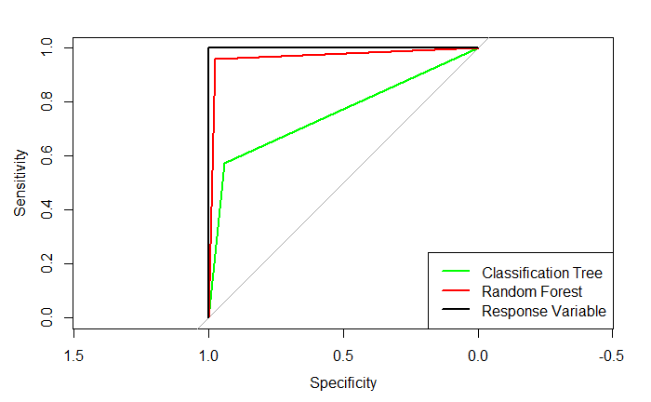
Performance Evaluation
Model | Decision Tree | Random Forest
Accuracy | 0.90 | 0.97
AUC | 0.74 | 0.90
Random Forest model performed better than Decision Tree in accuracy and AUC.
Random Forest model’s ROC curve is the closest to the ideal.
Conclusion: Use Random Forest with hyperparameter optimization

